Slide 1




Chongqing University of Technology
ATAI
Advanced Technique of Artificial Intelligence
Chongqing University of Technology
Relational Graph Attention Network for Aspect-based Sentiment Analysis
(ACL-2020)
Reported by Ling Zhu

Slide 2

Chongqing University of Technology
ATAI
Advanced Technique of Artificial Intelligence
Chongqing University of Technology
1. Introduction
2. Innovation
3. Method
4. Experiments
5. Conclusion

Slide 3
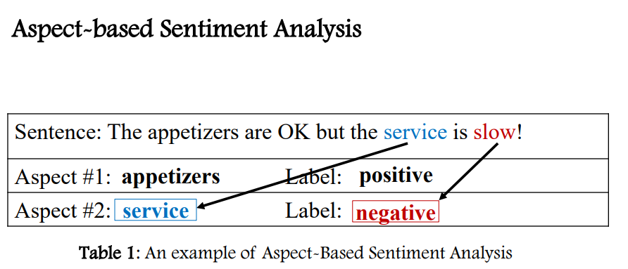
Introduction

Slide 4
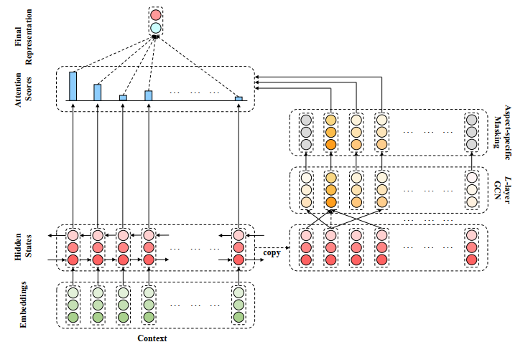
Introduction
previous methods:
Aspect-based Sentiment Classification with Aspect-specific Graph Convolutional Networks,EMNLP,2019

Slide 5
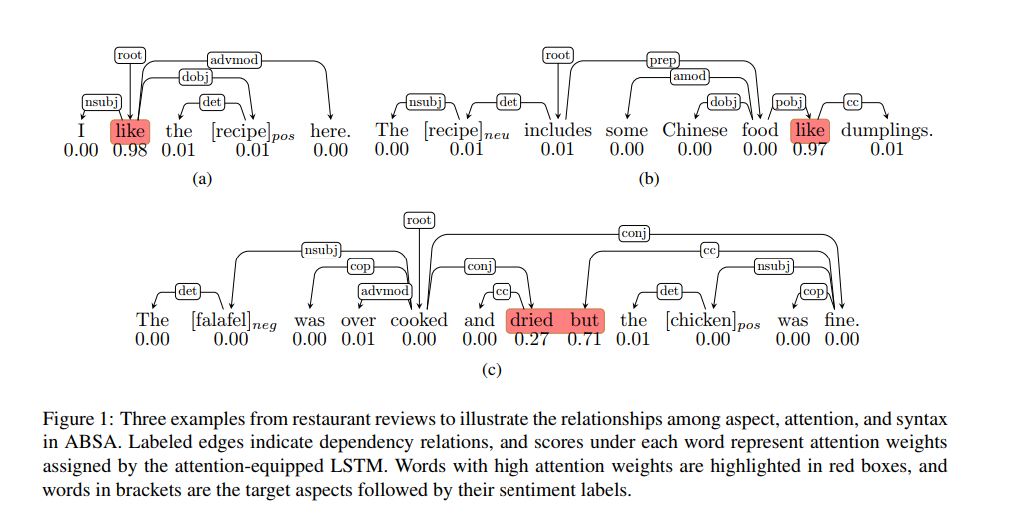
Introduction
attention-based LSTM

Slide 6
Introduction
Current issues:
Opinion words are far from aspect words
One sentence contains multiple aspects(1-N) with different sentiments,
which may confuse the models
aspect
Example 1: So delicious was the noodles but terrible vegetables
Example 2: great food but the service was dreadful
$${Weight}_{delicious}<{Weight}_{terrible}$$

Slide 7
Motivation
an aspect-oriented tree structure by reshaping and pruning ordinary dependency trees to focus on the target aspects
a new GAT model to encode the dependency relations and to establish the connections between aspects and opinion words

Slide 8
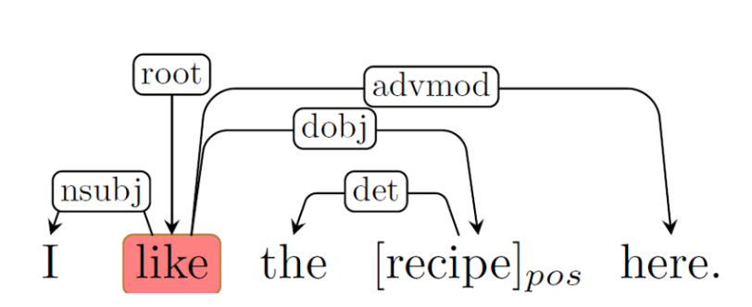
Approach
Dependency tree
Aspect-based dependency tree
Step1: First, a dependency tree is obtained using a parser

Slide 9
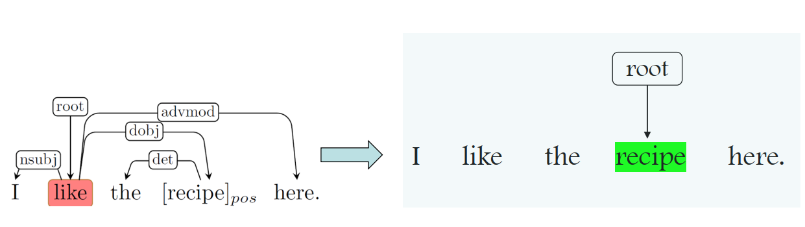
Approach
Dependency tree
Aspect-based dependency tree
Step2: Second, we place the target aspect at the root

Slide 10
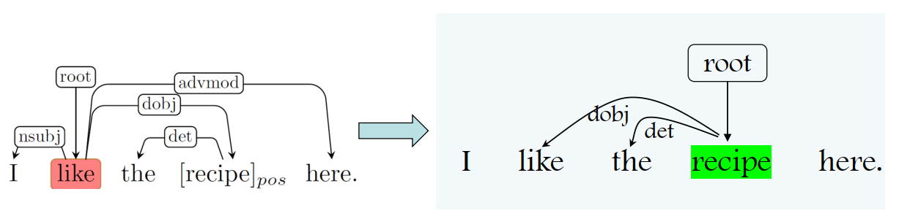
Approach
Dependency tree
Aspect-based dependency tree
Step3: we set the nodes with direct connections to the aspect as the children,
for which the original dependency relations remain unchanged

Slide 11
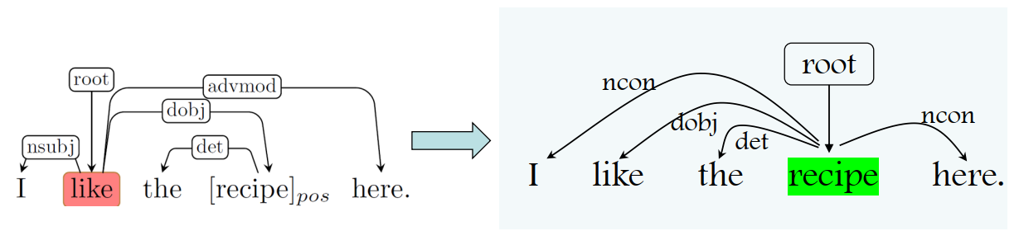
Approach
Dependency tree
Aspect-oriented dependency tree
Step4: other original dependency relations are discarded,and instead,
we put a virtual relation “n:con"(n connected) from each node to the aspect.

Slide 12
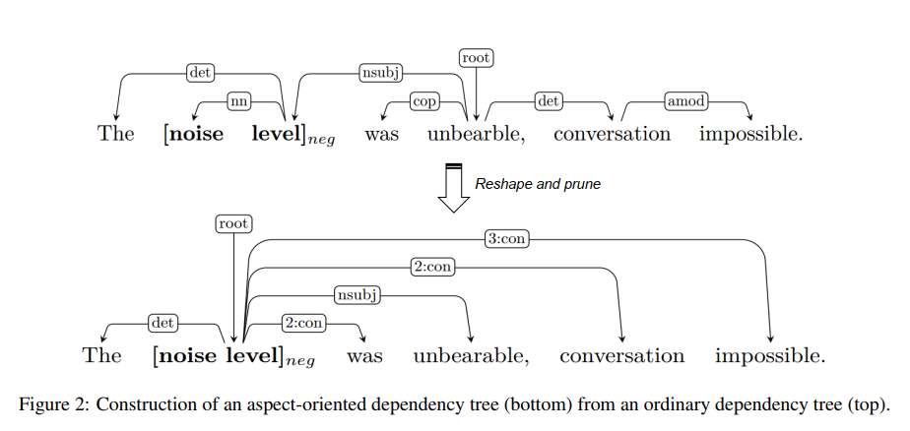
Approach
Aspect-Oriented Dependency Tree

Slide 13
Approach
Graph Attention Network
Relational Graph Attention Network
Notes:
Graph Attention Networks ,ICLR,2018

Slide 14
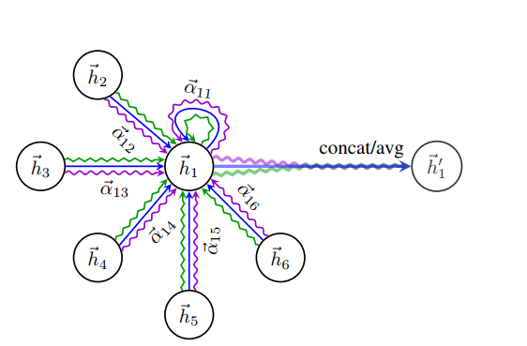
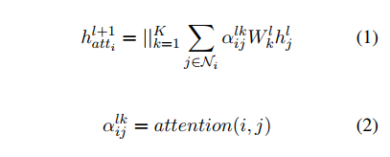
Approach
Graph Attention Network
Graph Attention Networks ,ICLR,2018 https://arxiv.org/pdf/1710.10903
Notes:
Graph Attention Networks ,ICLR,2018

Slide 15
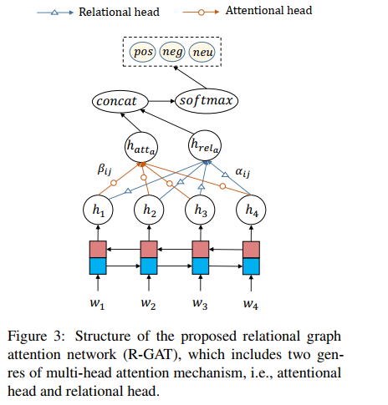
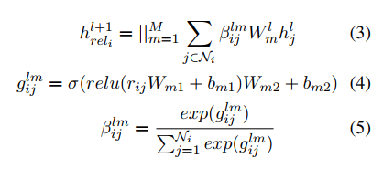


Approach
Relational Graph Attention Network
K:multi head nums
M:relation nums

Slide 16
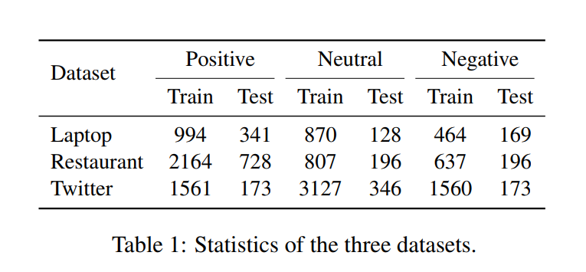
Experiments

Slide 17
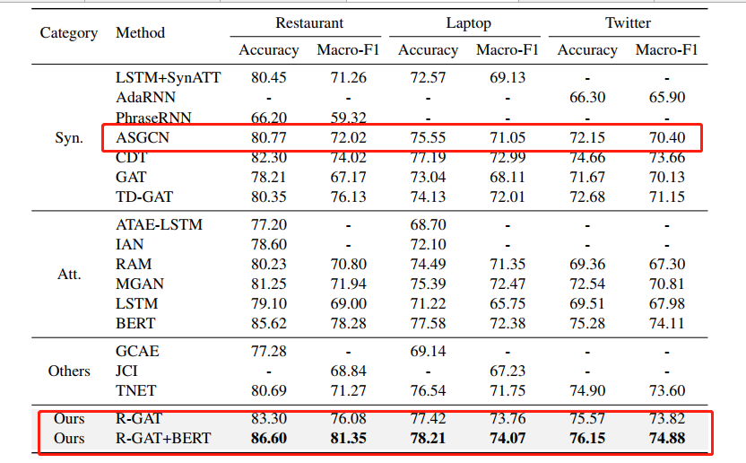
Experiments

Slide 18
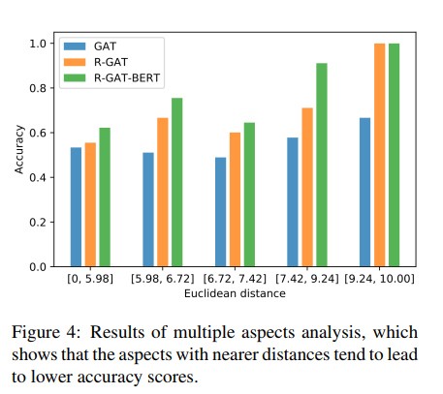
Experiments

Slide 19
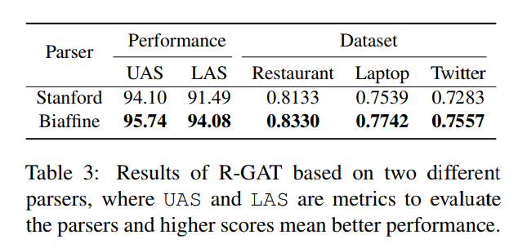
Experiments

Slide 20
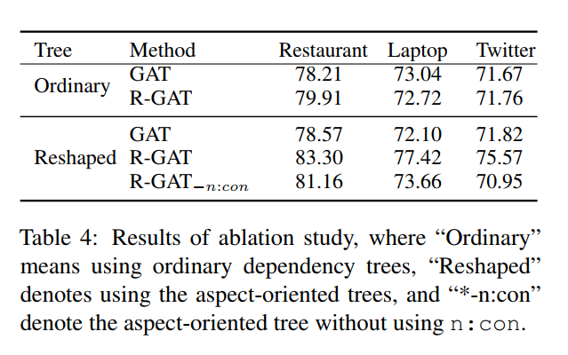
Experiments

Slide 21
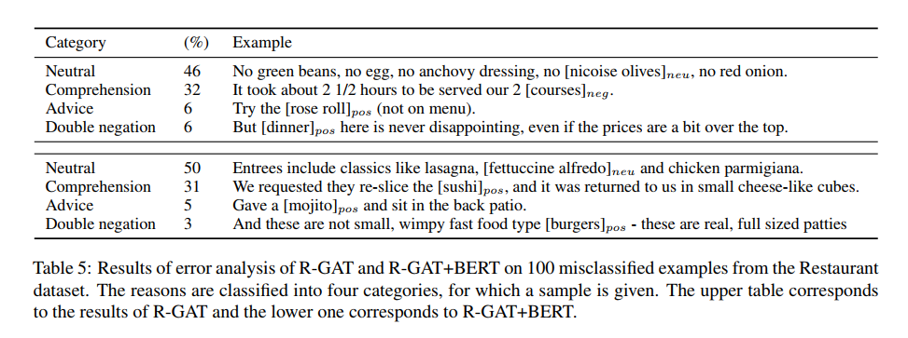
Experiments

Slide 22
Conclusion
1. first defined a novel aspect-oriented dependency tree structure by reshaping and pruning an ordinary dependency parse tree to root it at a target aspect
2.encode the new dependency trees with our relational graph attention network (R-GAT) for sentiment classification

Slide 23
Thanks

